Slide 1
Parsing
Predictive Parsing

Slide 2
Predictive Parsing
LL(1) Grammars
Can do predictive parsing
Can select the right rule
Looking at only the next 1 input symbol
First L : Left to Right Scanning
Second L: Leftmost derivation
1 : one input symbol look-ahead for predictive decision
LL(k) Grammars
Can do predictive parsing
Can select the right rule
Looking at only the next k input symbols
Techniques to modify the grammar:
Left Factoring
Removal of Left Recursion
LL(k) Language
Can be described with an LL(k) grammar

Slide 3
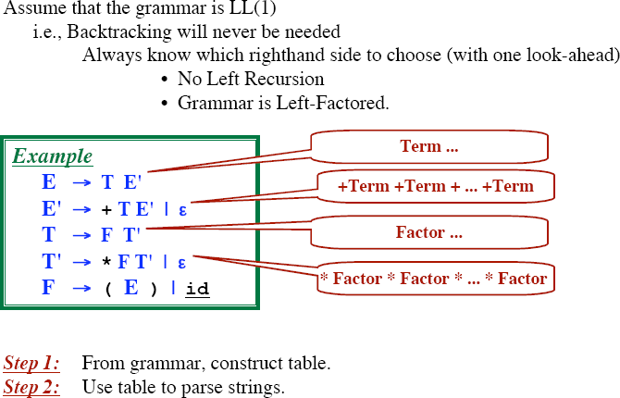
Table Driven Predictive Parsing

Slide 4
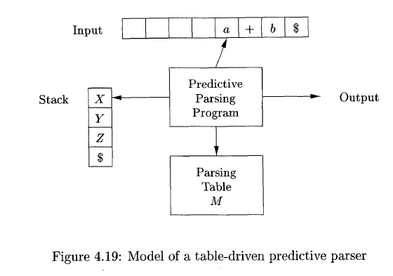
Table Driven Predictive Parsing

Slide 5
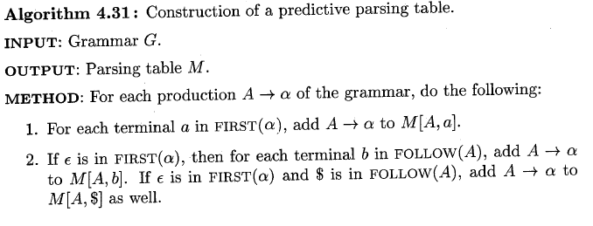

Table Driven Predictive Parsing

Slide 6
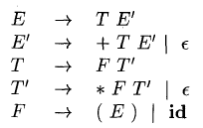
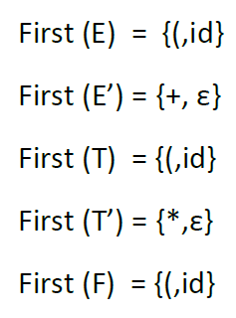
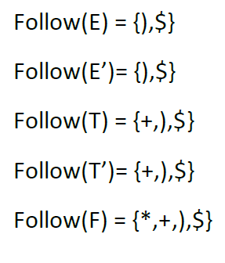
Table Driven Predictive Parsing Example
Step 1: Find First and Follow for non terminals:

Slide 7

Table Driven Predictive Parsing
Step 2: Build Parsing Table M
Take Production Rule: E→ TE’
First (TE’)={(,id}
Add E→ TE’ to M[ E, ( ] and M [ E, id ]
 | id | + | * | ( | ) | $
E | E→ TE’ |  |  | E→ TE’
E’
T
T’
F

Slide 8
Table Driven Predictive Parsing
Step 2: Build Parsing Table M
Take next Production Rule: E’→ +TE’
First (+TE’)={+}
Add E’→ +TE’ to M[ E’, + ]
 | id | + | * | ( | ) | $
E | E→ TE’ |  |  | E→ TE’
E’ |  | E’→ +TE’
T
T’
F

Slide 9
Table Driven Predictive Parsing
Step 2: Build Parsing Table M
Take next Production Rule: E’→ €
First (€) = {€}
Follow (E’) = {),$}
Add E’→ € to M[ E’, ) ] and M[ E’, $ ]
 | id | + | * | ( | ) | $
E | E→ TE’ |  |  | E→ TE’
E’ |  | E’→ +TE’ |  |  | E’→ € | E’→ €
T
T’
F

Slide 10
Table Driven Predictive Parsing
Step 2: Build Parsing Table M
Take next Production Rule: T→ FT’
First (FT’) = {(,id}
Add T→ FT’ to M[ T, ( ] and M [ T, id ]
 | id | + | * | ( | ) | $
E | E→ TE’ |  |  | E→ TE’
E’ |  | E’→ +TE’ |  |  | E’→ € | E’→ €
T | T→ FT’ |  |  | T→ FT’
T’
F

Slide 11
Table Driven Predictive Parsing
Step 2: Build Parsing Table M
Take next Production Rule: T’→ *FT’
First (*FT’) = {*}
Add T’→ *FT’ to M[ T’, * ]
 | id | + | * | ( | ) | $
E | E→ TE’ |  |  | E→ TE’
E’ |  | E’→ +TE’ |  |  | E’→ € | E’→ €
T | T→ FT’ |  |  | T→ FT’
T’ |  |  | T’→ *FT’
F

Slide 12
Table Driven Predictive Parsing
Step 2: Build Parsing Table M
Take next Production Rule: T’→€
First (€) = {€}
Follow (T’) = {+, ) , $}
Add T’→€ to M[ T’, + ], M[ T’, ) ] and M[ T’, $ ]
 | id | + | * | ( | ) | $
E | E→ TE’ |  |  | E→ TE’
E’ |  | E’→ +TE’ |  |  | E’→ € | E’→ €
T | T→ FT’ |  |  | T→ FT’
T’ |  | T’→€ | T’→ *FT’ |  | T’→€ | T’→€
F

Slide 13
Table Driven Predictive Parsing
Step 2: Build Parsing Table M
Take next Production Rule: F → (E)
First ((E)) = {(}
Add F → (E) to M[ F, ( ]
 | id | + | * | ( | ) | $
E | E→ TE’ |  |  | E→ TE’
E’ |  | E’→ +TE’ |  |  | E’→ € | E’→ €
T | T→ FT’ |  |  | T→ FT’
T’ |  | T’→€ | T’→ *FT’ |  | T’→€ | T’→€
F |  |  |  | F → (E)

Slide 14
Table Driven Predictive Parsing
Step 2: Build Parsing Table M
Take next Production Rule: F → id
First (id) = {id}
Add F → id to M[ F, id ]
 | id | + | * | ( | ) | $
E | E→ TE’ |  |  | E→ TE’
E’ |  | E’→ +TE’ |  |  | E’→ € | E’→ €
T | T→ FT’ |  |  | T→ FT’
T’ |  | T’→€ | T’→ *FT’ |  | T’→€ | T’→€
F | F → id |  |  | F → (E)

Slide 15
Table Driven Predictive Parsing
 | id | + | * | ( | ) | $
E | E→ TE’ |  |  | E→ TE’
E’ |  | E’→ +TE’ |  |  | E’→ € | E’→ €
T | T→ FT’ |  |  | T→ FT’
T’ |  | T’→€ | T’→ *FT’ |  | T’→€ | T’→€
F | F → id |  |  | F → (E)

Slide 16
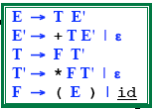
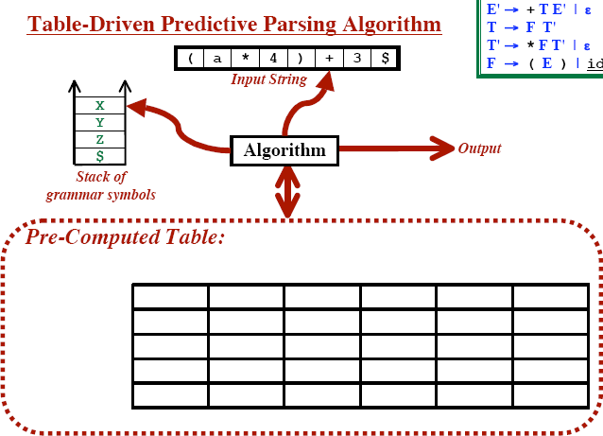
Table Driven Predictive Parsing

Slide 17
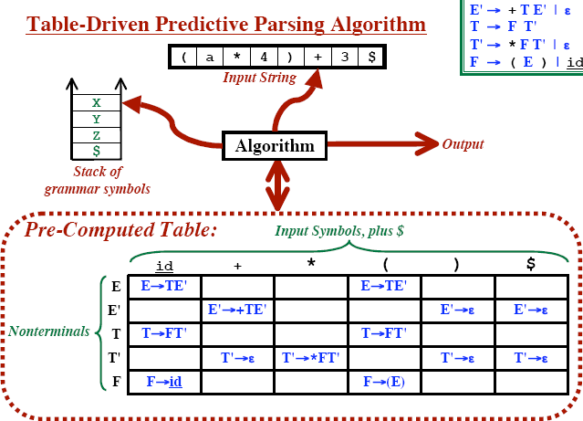
Table Driven Predictive Parsing

Slide 18
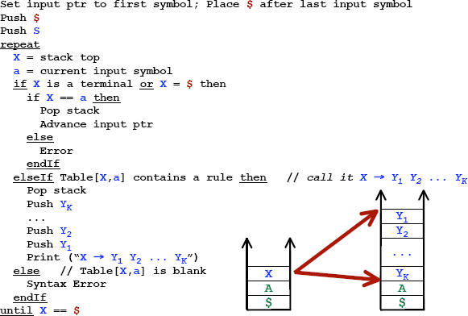
Predictive Parsing Algorithm

Slide 19
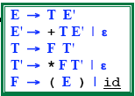
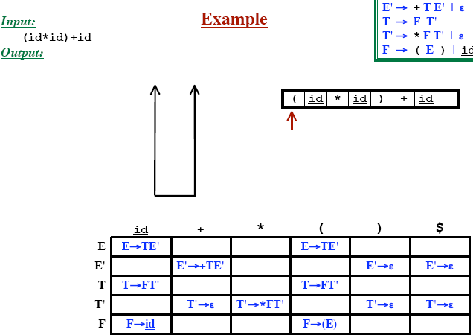
Predictive Parsing

Slide 20
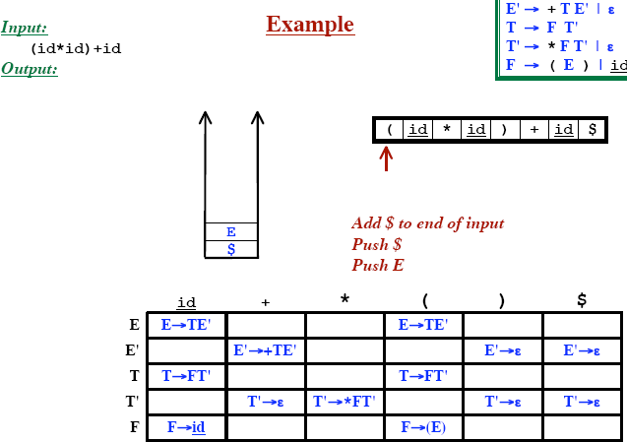
Predictive Parsing

Slide 21
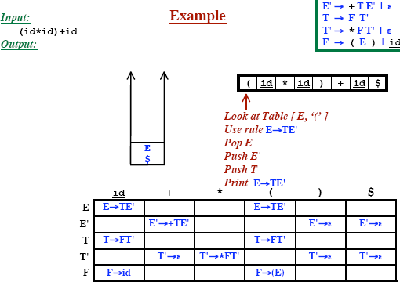
Predictive Parsing

Slide 22
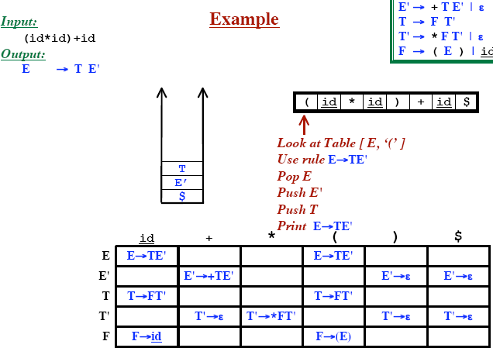
Predictive Parsing

Slide 23
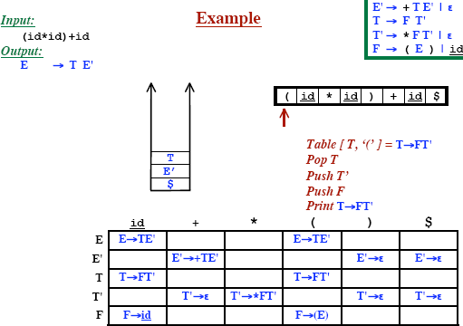
Predictive Parsing

Slide 24
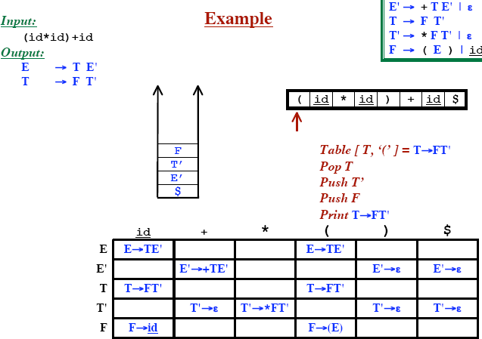
Predictive Parsing

Slide 25
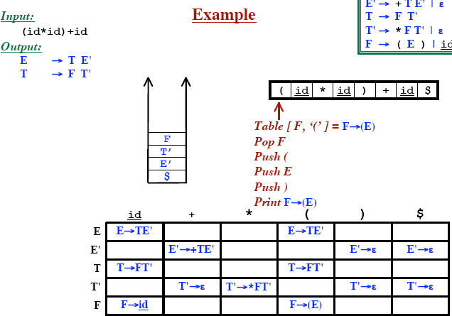
Predictive Parsing

Slide 26
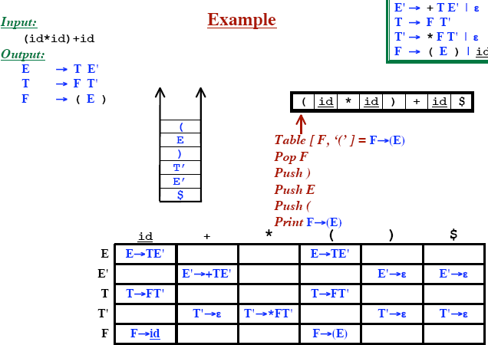
Predictive Parsing

Slide 27
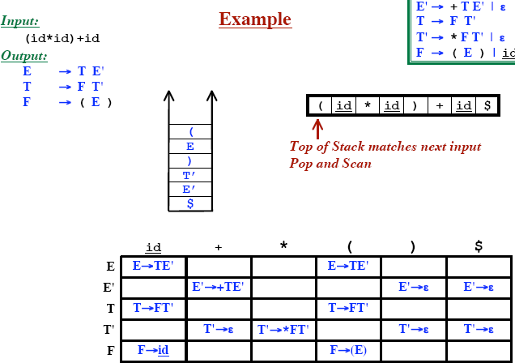
Predictive Parsing

Slide 28
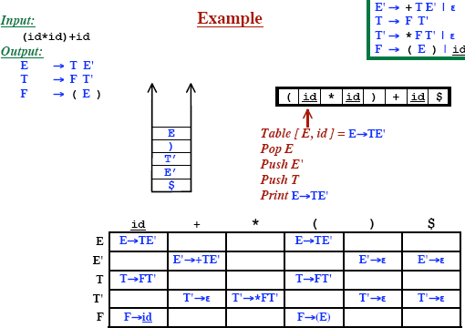
Predictive Parsing

Slide 29
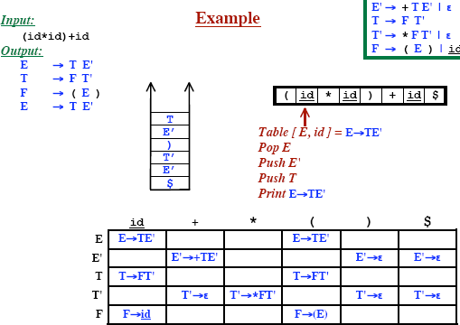
Predictive Parsing

Slide 30
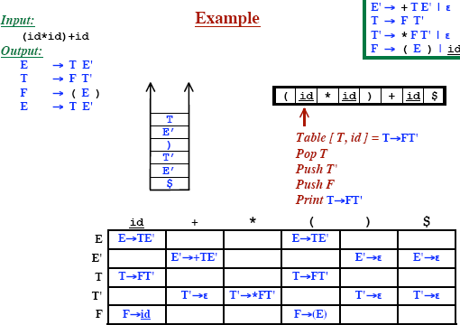
Predictive Parsing

Slide 31
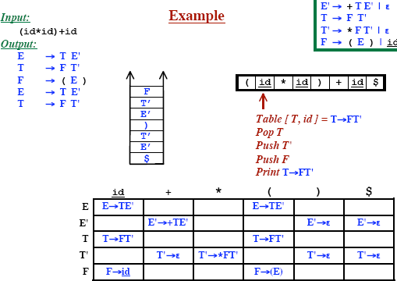
Predictive Parsing

Slide 32
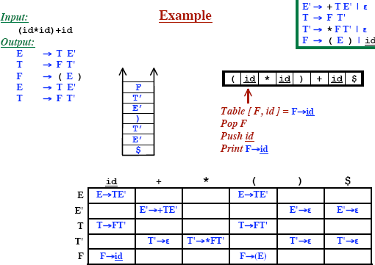
Predictive Parsing

Slide 33
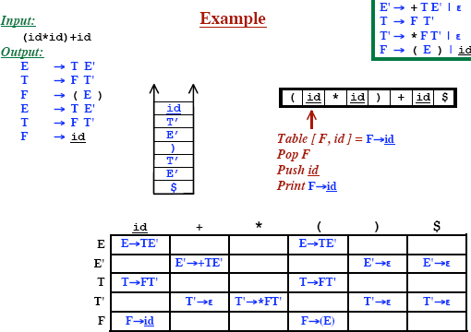
Predictive Parsing

Slide 34
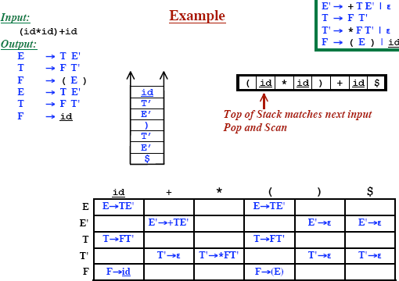
Predictive Parsing

Slide 35
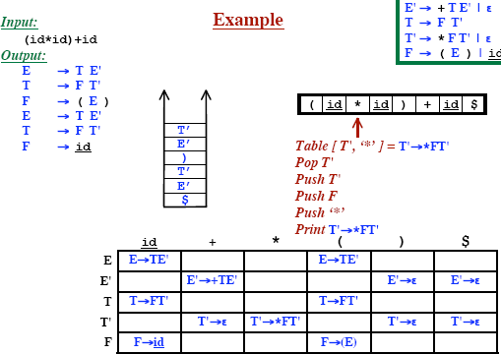
Predictive Parsing

Slide 36
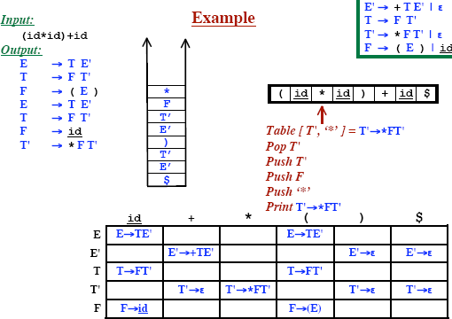
Predictive Parsing

Slide 37
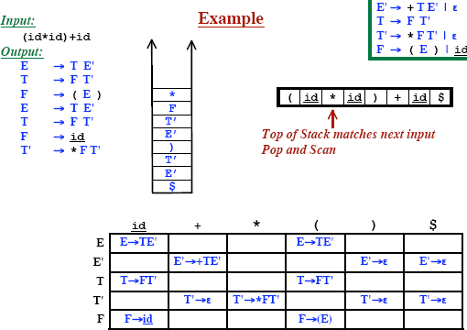
Predictive Parsing

Slide 38
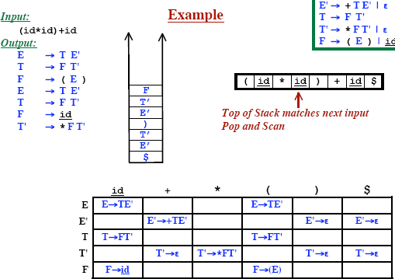
Predictive Parsing

Slide 39
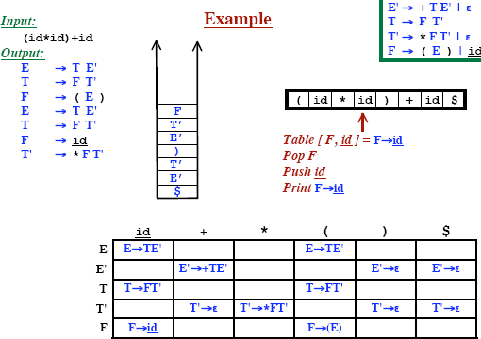
Predictive Parsing

Slide 40
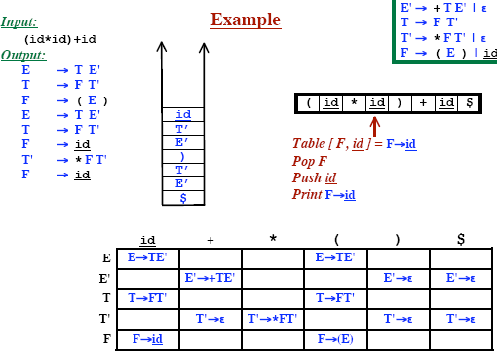
Predictive Parsing

Slide 41

Predictive Parsing

Slide 42

Predictive Parsing

Slide 43
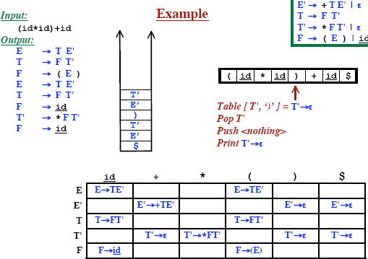
Predictive Parsing

Slide 44
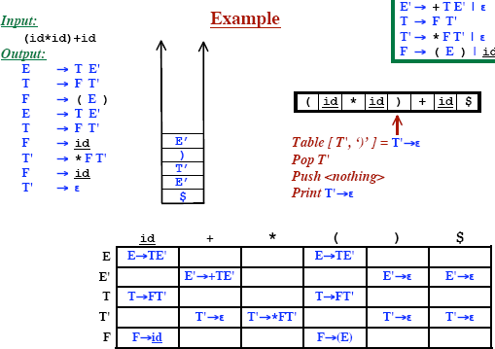
Predictive Parsing

Slide 45
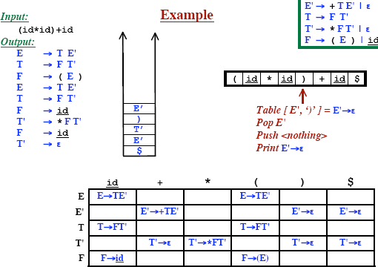
Predictive Parsing

Slide 46

Predictive Parsing

Slide 47
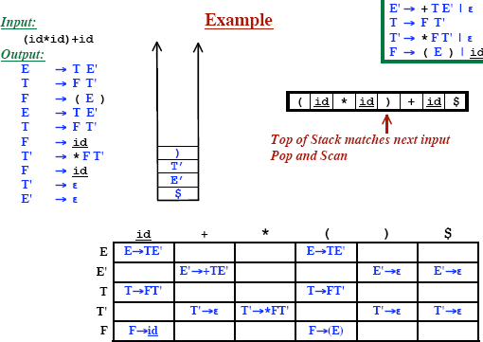
Predictive Parsing

Slide 48
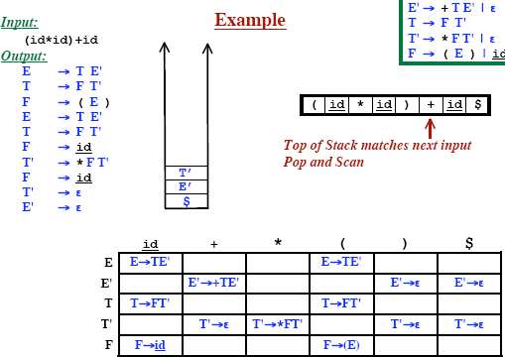
Predictive Parsing

Slide 49
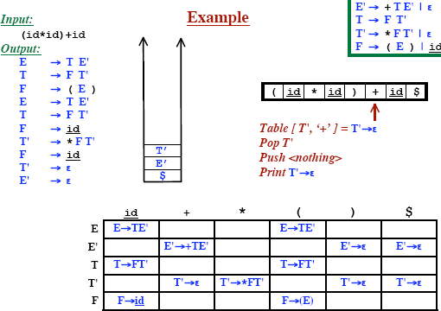
Predictive Parsing

Slide 50
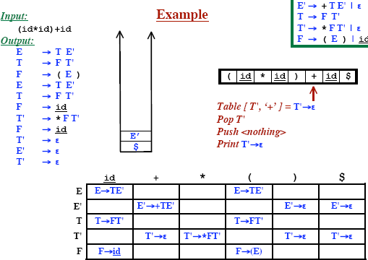
Predictive Parsing

Slide 51
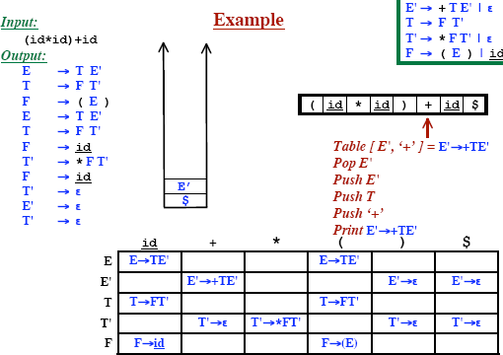
Predictive Parsing

Slide 52

Predictive Parsing

Slide 53

Predictive Parsing

Slide 54
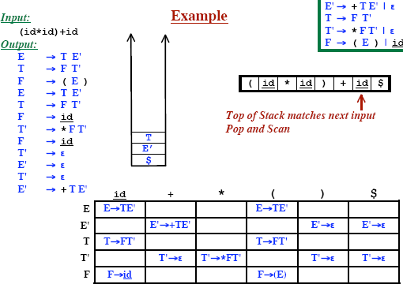
Predictive Parsing

Slide 55
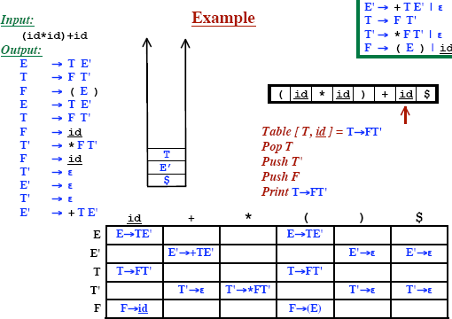
Predictive Parsing

Slide 56
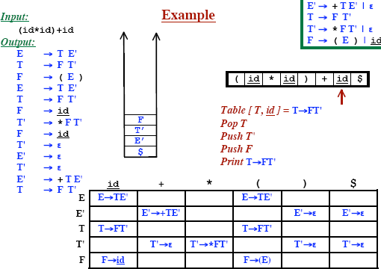
Predictive Parsing

Slide 57
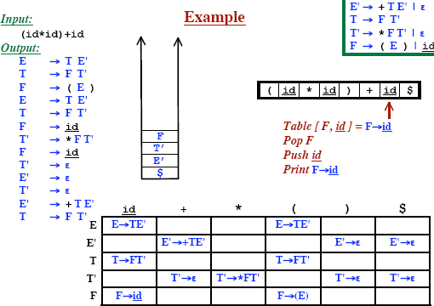
Predictive Parsing

Slide 58
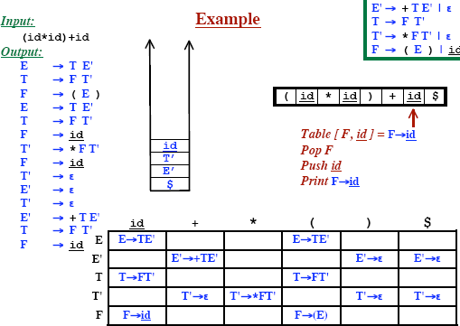
Predictive Parsing

Slide 59
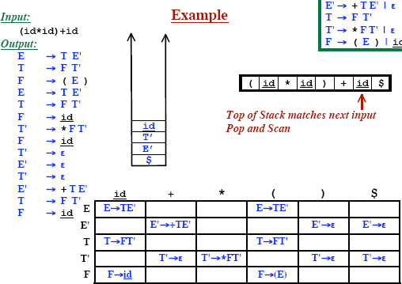
Predictive Parsing

Slide 60
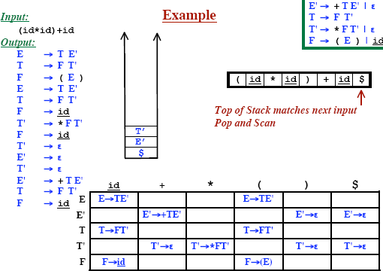
Predictive Parsing

Slide 61
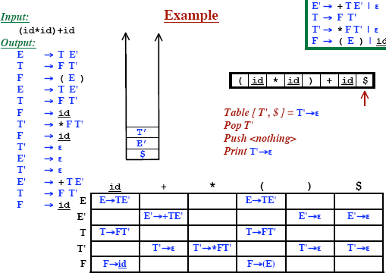
Predictive Parsing

Slide 62
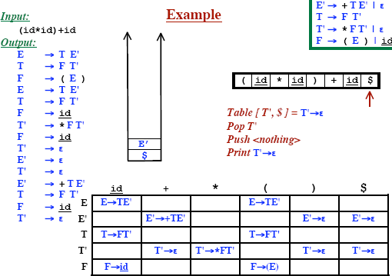
Predictive Parsing

Slide 63

Predictive Parsing

Slide 64

Predictive Parsing

Slide 65

Predictive Parsing

Slide 66






Reconstructing the Parse Tree

Slide 67


Reconstructing the Parse Tree

Slide 68


Reconstructing the Parse Tree

